Slide 1
South Carolina Arts Commission
FY 2022-23 Budget Hearing

Slide 2
Agency Attendees
David Platts, Executive Director
Milly Hough, Senior Deputy Director
Ashley Brown, Deputy Director
Angela Brewbaker, Finance Director

Slide 3
Agency Information
The South Carolina Arts Commission
is the only state organization charged with supporting and providing leadership for the arts statewide.
works to ensure that all S.C. citizens and visitors benefit from diverse opportunities for rewarding arts experiences, with emphasis on rural, high poverty and minority communities.
FY2021 grants - awarded $4.65 million through 538 grants to support community arts activities, artists and school-based arts programs, and emergency relief around the state.
Arts Emergency Relief Grants: $215,200 through 153 grants
Annual Grants: $4.42 million through 385 grants

Slide 4
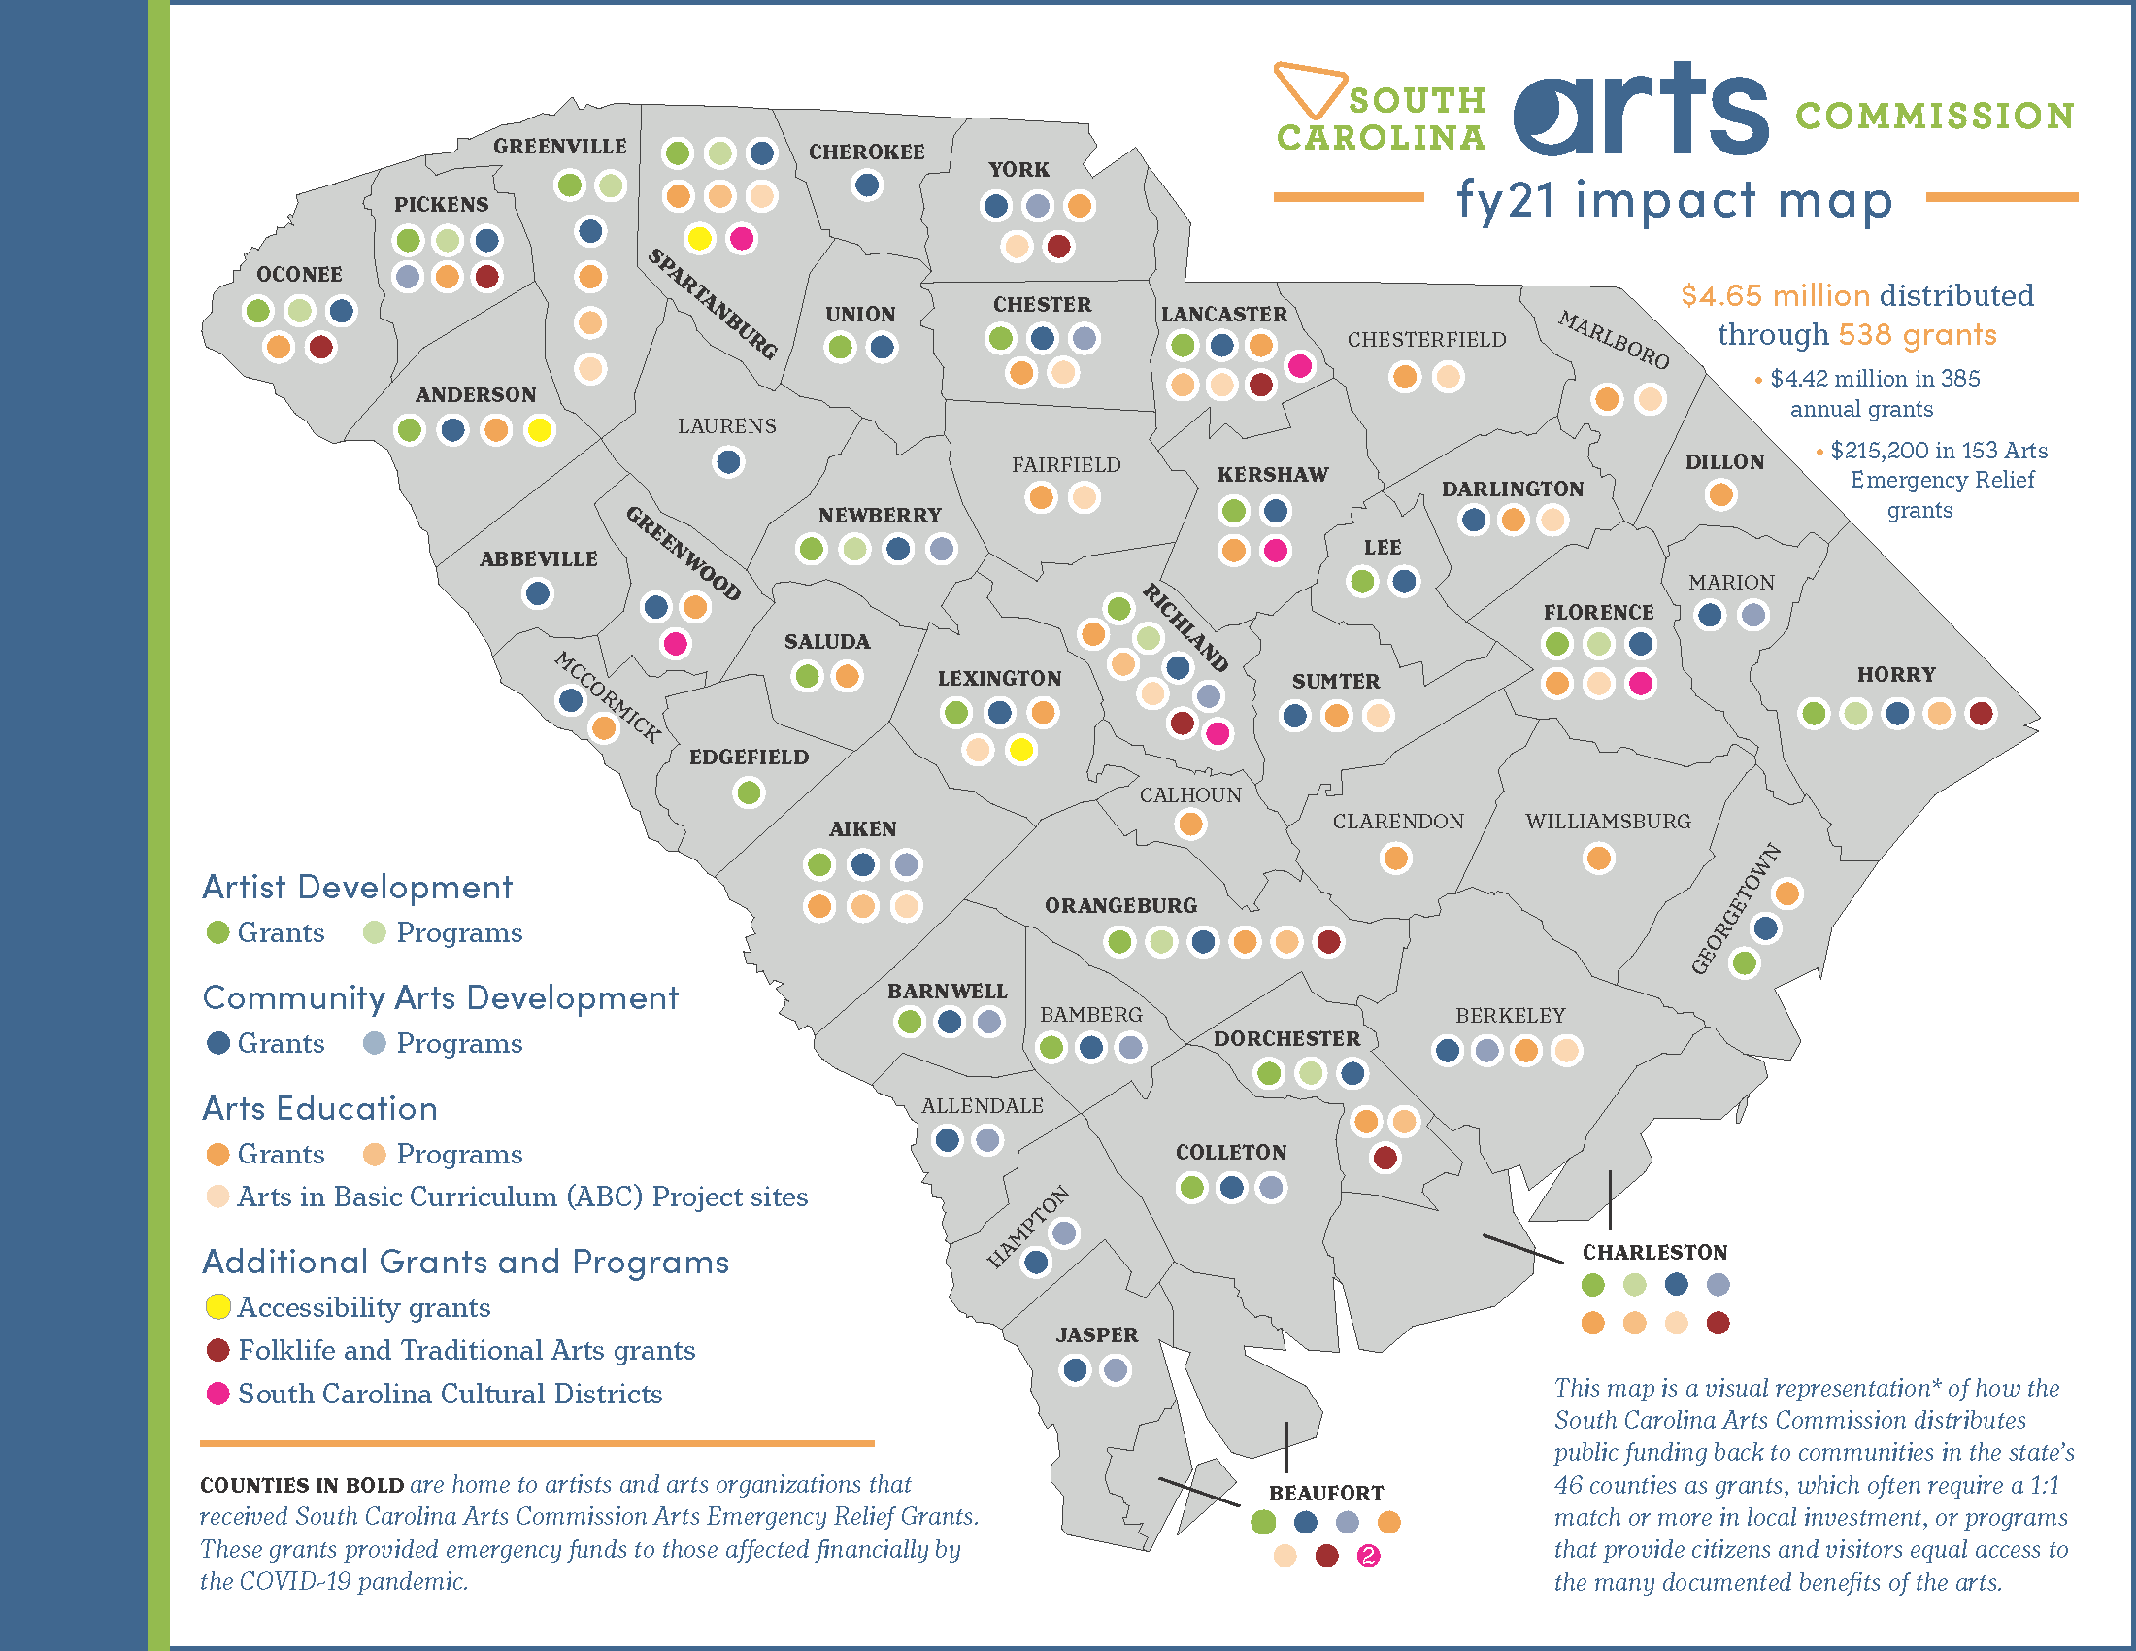
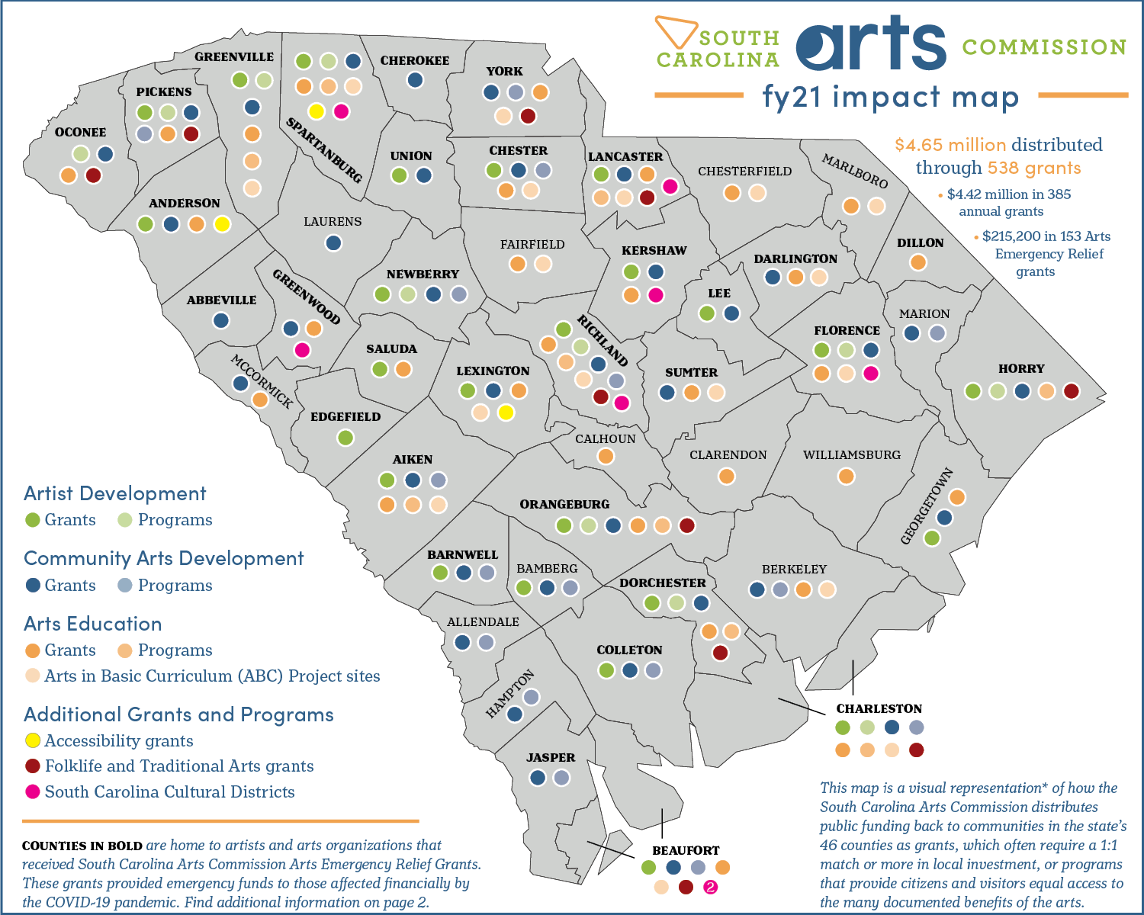

Slide 5
Recurring Budget Request
Arts Commission’s fundamental goal: to promote equitable access to the arts and support the cultivation of creativity in South Carolina.
How we accomplish this goal: through support of the statewide network of local arts providers.
Request: $5,000,000 in new recurring funds to increase investment in local arts organizations through Operating Support grants and additional staff support.

Slide 6
Recurring Request Justification
Operating Support grants provide flexible, unrestricted funding to support operations and programming.
FY2021: Unable to fund additional new 19 applicants.
FY2022: New recurring funds of $1.5 million enabled SCAC to increase operating support grants for current grantees.
Applications are now open to new grantees. We expect applications from the previous 19 who were unfunded, plus an estimated 20 – 30 additional new applicants.
Full funding of this request will allow SCAC to keep operating support funding at current levels, add new applicants, and increase capacity to support the arts industry throughout the state.

Slide 7
Recurring Request Justification
Full funding of our FY2023 request will also enable SCAC to expand existing programs to support the arts industry throughout the state by hiring additional coordinators.

Slide 8
Nonrecurring Budget Request
Arts Commission’s fundamental goal: to promote equitable access to the arts and support the cultivation of creativity in South Carolina.
How we accomplish this goal: through support of the statewide network of local arts providers.
Request: $500,000 in nonrecurring funds to develop an Arts Industry program to help communities connect to resources and capitalize on economic development opportunities.

Slide 9
Nonrecurring Budget Request Justification
Community arts providers are key components of the statewide arts industry that contributes $9.7 billion to South Carolina’s economy.
Small or rural communities have fewer resources to take advantage of the economic benefits of the arts.
SCAC staff, including a new arts industry director, can connect local communities to statewide, regional, and national resources to help them strengthen economic vitality through the arts.
These nonrecurring funds will enable SCAC to work with an existing network of rural mayors to pilot creative placemaking experiences.

